Slide 1

HTTP Protocol​
Handling Requests, ​ Constructing Responses, HTTP/2
SoftUni Team
Technical Trainers
Software University
http://softuni.bg

Slide 2
Table of Contents
Http Basics
URL
Http Request
Http Response
MIME and Media types
Web Server
Html Forms
2

Slide 3
Questions?
sli.do
#Java-Web
3

Slide 4

HTTP Basics​
Request and Responses

Slide 5


Hyper Text Transfer Protocol
Request
Response
HTTP
HTTP
TCP
TCP
IP
IP
Ethernet
Media (wires / air / fiber)
Ethernet
3
Notes:
HTTP == Hyper Text Transfer Protocol
Client-server protocol for transferring Web resources (HTML files, images, styles, scripts, data, etc.)
The widespread protocol for Internet communication today
Request-response model (client requests, server answers)
Text-based format (human readable)
Relies on unique resource URLs
Provides resource metadata (e.g. encoding)
Stateless (cookies and Web storages can overcome this)
© Software University Foundation – http://softuni.org
This work is licensed under the Creative Commons Attribution-NonCommercial-ShareAlike license.
53

Slide 6
HTTP Request Methods
HTTP defines methods to indicate the desired action to be
performed on the identified resource
Method | Description
GET | Retrieve / load a resource
POST | Create / store a resource
PUT | Update a resource
DELETE | Remove a resource
3

Slide 7
HTTP Conversation: Example
GET /courses/javascript HTTP/1.1
Host: www.softuni.bg
User-Agent: Mozilla/5.0
<CRLF>
HTTP request:
HTTP response:
The empty line denotes the end of the request header
HTTP/1.1 200 OK
Date: Mon, 5 Jul 2010 13:09:03 GMT
Server: Microsoft-HTTPAPI/2.0
Last-Modified: Mon, 12 Jul 2014 15:33:23 GMT
Content-Length: 54
<CRLF>
<html><title>Hello</title>
Welcome to our site</html>
The empty line denotes the end of the response header
3

Slide 8

URL
Uniform Resource Locator

Slide 9
Uniform Resource Locator (URL)
http://mysite.com:8080/demo/index.php?id=27&lang=en#lectures
Protocol
Host
Port
Path
Query String
Fragment
URL is a formatted string, consisting of:
Protocol for communicating (http, ftp, https...) – HTTP in most cases
Host or IP address (www.softuni.bg, gmail.com, 127.0.0.1, web)
Port (the default port is 80) – a number in range [0…65535]
Path (/forum, /path/index.php)
Query string (?id=27&lang=en)
Fragment (#lectures) – used on the client to navigate to some section
9

Slide 10
URL Encoding
URLs are encoded according RFC 1738:
Safe URL characters: [0-9a-zA-Z], $, -, _, . , +, *, ', (, ), ,, !
All other characters are escaped by:
Space is encoded as "+" or "%20"
Example:
URL-encoded string:
Char | URL Encoding
space | %20
щ | %D1%89
" | %22
# | %23
$ | %24
% | %25
& | %26
%[character hex code]
Наков-爱-SoftUni
%D0%9D%D0%B0%D0%BA%D0%BE%D0%B2-%E7%88%B1-SoftUni
9

Slide 11
Valid and Invalid URLs – Examples
Some valid URLs:
Some invalid URLs:
http://www.google.bg/search?sourceid=navclient&ie=UTF-8&rlz=1T4GGLL_enBG369BG369&q=http+get+vs+post
http://bg.wikipedia.org/wiki/%D0%A1%D0%BE%D1%84%D1%82%D1%83%D0%B5%D1%80%D0%BD%D0%B0_%D0%B0%D0%BA%D0%B0%D0%B4%D0%B5%D0%BC%D0%B8%D1%8F
Should be: ?q=C%23+.NET+4.0
http://www.google.bg/search?&q=C# .NET 4.0
Should be: ?q=%D0%B1 %D0%B8%D1%80%D0%B0
http://www.google.bg/search?&q=бира
9

Slide 12

HTTP Request​
What is a HTTP Request?

Slide 13
HTTP Request Message
Request message sent by a client consists of:
HTTP request line
Request method (GET / POST / PUT / DELETE / …)
Resource URI (URL)
Protocol version
HTTP request headers
Additional parameters
HTTP request body – optional data, e.g. posted form fields
<method> <resource> HTTP/<version>
<headers>
(empty line)
<body>
13

Slide 14
HTTP GET Request – Example
Example of HTTP GET request:
GET /index.html HTTP/1.1
Host: localhost
<CRLF>
HTTP request headers
HTTP request line
The request body is empty
13
Notes:
© Software University Foundation – http://softuni.org
This work is licensed under the Creative Commons Attribution-NonCommercial-ShareAlike license.
53

Slide 15
HTTP POST Request – Example
Example of HTTP POST request:
POST /login.html HTTP/1.1
Host: localhost
Content-Length: 59
<CRLF>
username=mente&password=top*secret!
<CRLF>
HTTP request line
HTTP request headers
The request body holds the submitted form data
13

Slide 16

HTTP Response​
What is a HTTP Response?

Slide 17
HTTP Response Message
The response message sent by the HTTP server consists of:
HTTP response status line
Protocol version
Status code
Status phrase
Response headers
Provide meta data about the returned resource
Response body
The content of the HTTP response (data)
HTTP/<version> <status code> <status text>
<headers>
(empty line)
<response body – the requested resource>
17

Slide 18
HTTP Response – Example
Example of HTTP response from the Web server:
HTTP response status line
HTTP/1.1 200 OK
Date: Fri, 17 Jul 2010 16:09:18 GMT+2
Server: Apache/2.2.14 (Linux)
Accept-Ranges: bytes
Content-Length: 84
Content-Type: text/html
<CRLF>
<html>
<head><title>Test</title></head>
<body>Test HTML page.</body>
</html>
HTTP response headers
HTTP response body
17

Slide 19
HTTP Response Codes
HTTP response code classes
1xx: informational (e.g., "100 Continue")
2xx: successful (e.g., "200 OK", "201 Created")
3xx: redirection (e.g., "304 Not Modified", "301 Moved Permanently", "302 Found")
4xx: client error (e.g., "400 Bad Request", "404 Not Found", "401 Unauthorized", "409 Conflict")
5xx: server error (e.g., "500 Internal Server Error", "503 Service Unavailable")
19

Slide 20
HTTP Response – Example
Example of HTTP response with error result:
HTTP response status line
HTTP/1.1 404 Not Found
Date: Fri, 17 Nov 2014 16:09:18 GMT+2
Server: Apache/2.2.14 (Linux)
Connection: close
Content-Type: text/html
<CRLF>
<html><head><title>404 Not Found</title></head>
<body>
<h1>Not Found</h1>
<p>The requested URL /img/logo.gif was not found on this server.</p> <hr><address>Apache/2.2.14 Server at Port 80</address>
</body></html>
HTTP response headers
The HTTP response body
19

Slide 21
Browser Redirection
HTTP GET requesting a moved URL:
The following HTTP response (301 Moved Permanently) tells
the browser to request another URL:
GET / HTTP/1.1
Host: http://softuni.org
User-Agent: Gecko/20100115 Firefox/3.6
<CRLF>
HTTP/1.1 301 Moved Permanently
Location: http://softuni.bg
…
19

Slide 22
Content-Type and Disposition
The Content-Type response header the server specifies how the output should be processed
Examples:
UTF-8 encoded HTML page. Will be shown in the browser.
Content-Type: text/html; charset=utf-8
Content-Type: application/pdf
Content-Disposition: attachment; filename="Report-April-2016.pdf"
This will download a PDF file named Report-April-2016.pdf
19

Slide 23

MIME and Media Types
Multi-Purpose Internet Mail Extensions

Slide 24
What is MIME?
MIME == Multi-Purpose Internet Mail Extensions
Internet standard for encoding resources
Originally developed for email attachments
Used in many Internet protocols like HTTP and SMTP
MIME defines several concepts
Content-Type, e.g. text/html, image/gif, application/pdf
Content charset, e.g. utf-8, ascii, windows-1251
Content-Disposition, e.g. attachment; filename=logo.jpg
Multipart messages (multiple resources in a single document)
19

Slide 25
Common MIME Media Types
MIME Type / Subtype | Description
application/json | JSON data
image/png | PNG image
image/gif | GIF image
text/html | HTML
text/plain | Text
text/xml | XML
video/mp4 | MP4 video
application/pdf | PDF document
19

Slide 26

HTTP
Tools for Developers

Slide 27
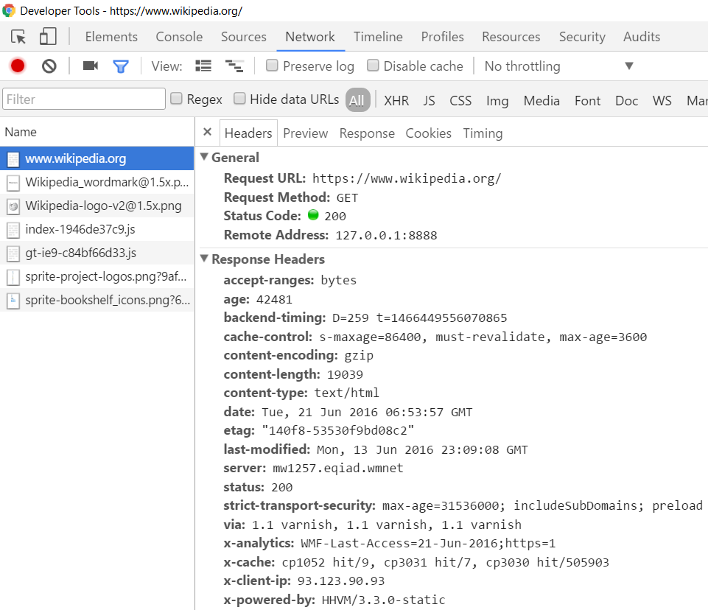
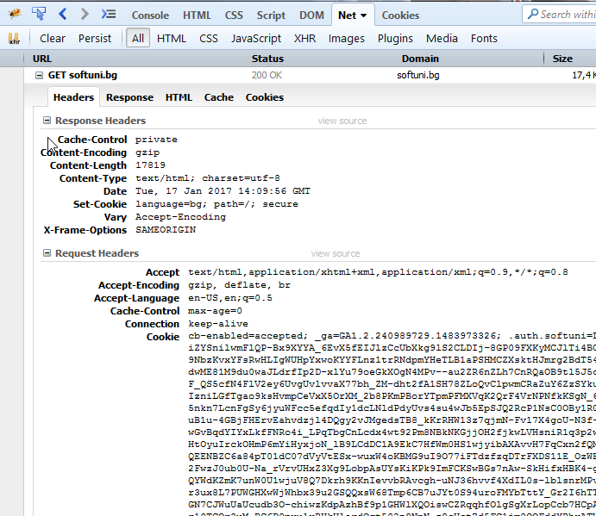
HTTP Tools for Developers - Browser
Chrome Developer Tools
Firebug
19

Slide 28


HTTP Tools for Developers - Browser (2)
Postman - Chrome
RESTClient - Firefox
19

Slide 29
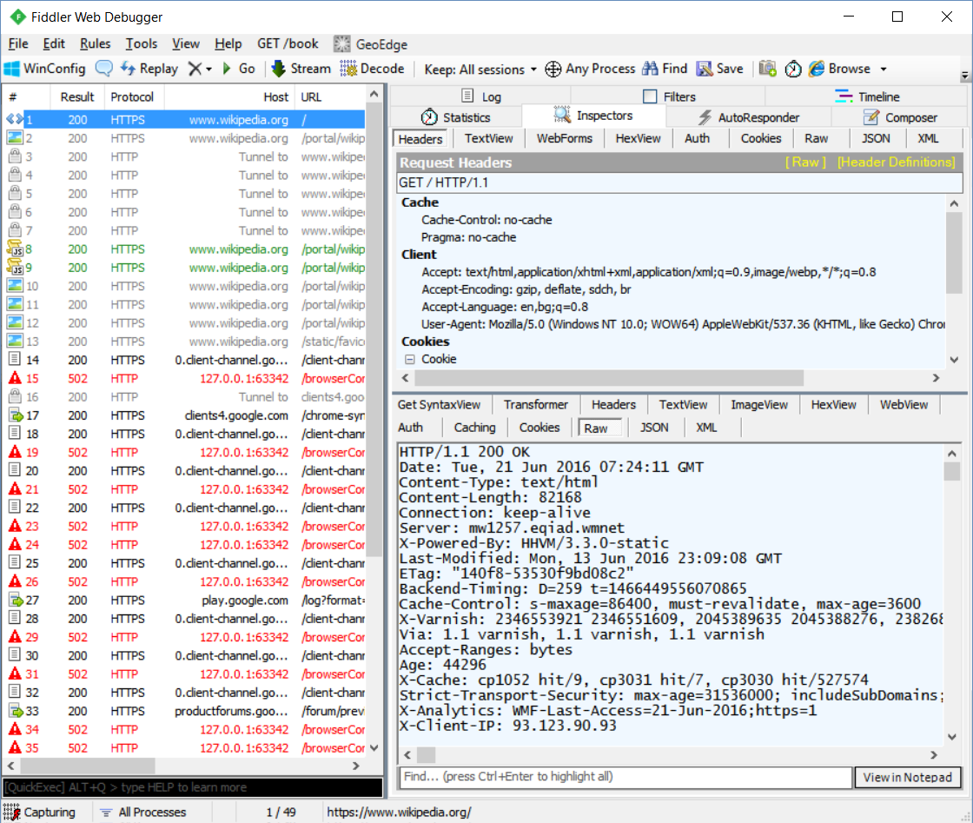
HTTP Tools for Developers - Desktop
Fiddler
19

Slide 30




Web Server

Slide 31

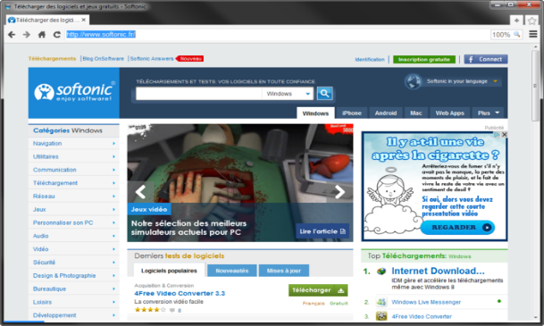



What is a Web Server?
Computer system that processes requests via HTTP, the basic network protocol
Web Client
Web Server
Communication
31

Slide 32

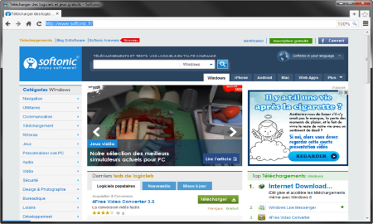
Web Server Work Model
Web Server
Web Resources
Web Client
Request
Protocol
Response
HTML, PDF, JPG…
Protocols:
HTTP FTP WebSocket
Protocol
Host
Port
Resource
URL
http://localhost:8000/softuni.jpg
31

Slide 33



Web Server Work Model (2)
Web Server
Technology
Web Client
Request
Protocol
Response
Web Resources
Database
HTML, PDF, JPG…
31

Slide 34


Web Server Work Model (3)
Web Server
Technology
Spring
Web Resources
Database
HTML, PDF, JPG…
31

Slide 35
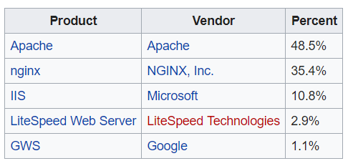

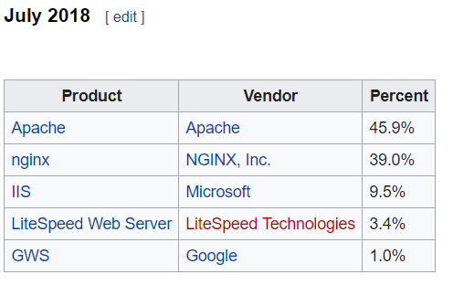

Most Popular Web Servers (W3Techs)
31

Slide 36
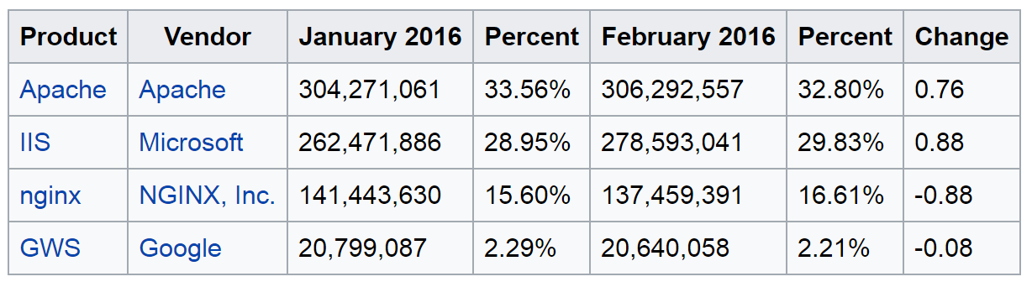
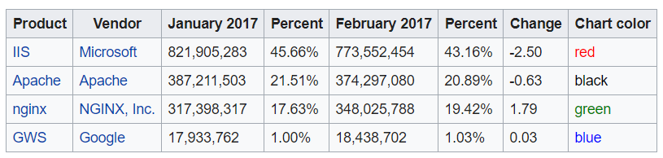
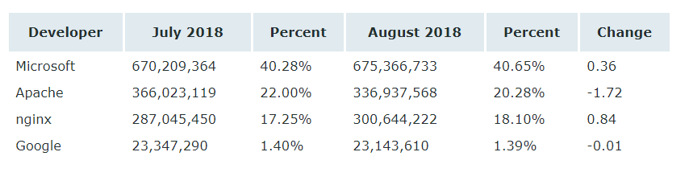
Most Popular Web Servers (NetCraft)
31

Slide 37



HTML Forms
Form Method and Action

Slide 38
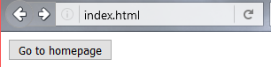
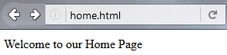
HTML Forms - Action Attribute
Defines where to submit the form data:
<form action="home.html">
<input type="submit" value="Go to homepage"/>
</form>
31

Slide 39
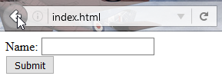
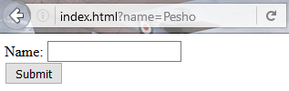
HTML Forms – Method Attribute
Specifies the HTTP method to use when sending form-data
<form method="get"> Name: <input type="text" name="name"> <br>
<input type="submit" value="Submit">
</form>
The form data is in the URL
31

Slide 40
HTML Forms – Method Attribute (2)
<form method="post"> Name: <input type="text" name="name"> <br>
<input type="submit" value="Submit">
</form>
POST http://localhost/index.html HTTP/1.1
Host: localhost
Content-Type: application/x-www-form-urlencoded
Content-Length: 10
name=Pesho
HTTP request body holds the form data
31

Slide 41
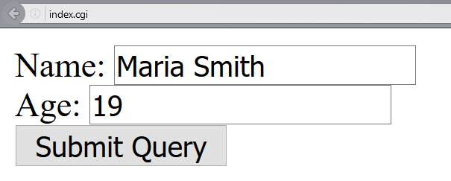
URL Encoded Form Data – Example
<form method="post">
Name: <input type="text" name="name"/> <br/>
Age: <input type="text" name="age"/> <br/>
<input type="submit" />
</form>
POST http://localhost/cgi-bin/index.cgi HTTP/1.1
Host: localhost
Content-Type: application/x-www-form-urlencoded
Content-Length: 23
name=Maria+Smith&age=19
File uploads are not supported
31

Slide 42

HTTP/2
What’s new? What’s better? What’s HTTP/2

Slide 43
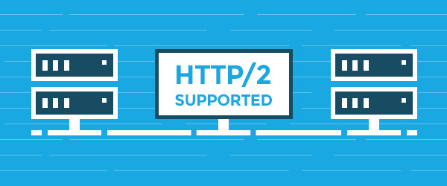
What’s HTTP/2
HTTP/2 (originally named HTTP/2.0) major revision of the HTTP network protocol used by the World Wide Web.
Supported by most of the popular web browsers (Chrome, Mozilla, Opera...)
Fast & Optimized. Meets modern web usage requirements.
Completely Backwards-Compatible.
As of January 2019, 32.5% of the top 10 million websites support HTTP/2 (W3Techs statistics).
43

Slide 44

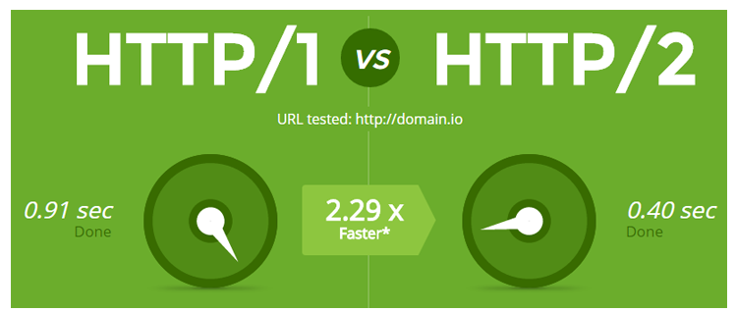
What’s new?
HTTP/2 is meant to erase the need of maintaining complex server infrastructures in order to perform well.
HTTP/2 communicates in binary data frames.
HTTP/2 introduces several new important elements:
HTTP/2 Multiplexing
HTTP/2 Header Compression
HTTP/2 Server Push
44

Slide 45
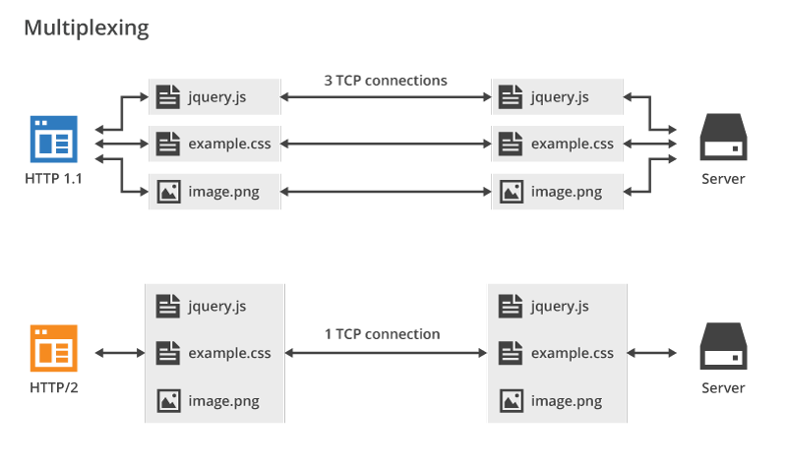
HTTP/2 Multiplexing
The art of handling multiple streams over a single TCP connection.
45

Slide 46
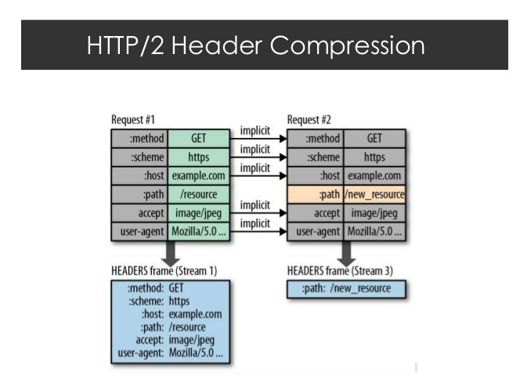
HTTP/2 Header Compression
HTTP/2 maintains a HTTP Header Table across requests.
Optimizes communication drastically.
The process is essentially a de-duplication, rather than compression.
46

Slide 47
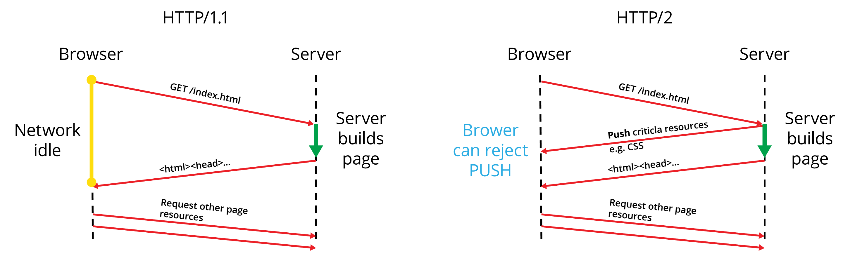
HTTP/2 Server Push
HTTP/2 Server Push is the process of sending resources to clients, without them having to ask for it.
47

Slide 48




Summary
What is HTTP?
HTML Forms & Actions.
URLs.
What is a Web Server?
Beneath the sheets of Web Communication.
How to handle HTTP Requests?
How to construct HTTP Responses?
48

Slide 49
https://softuni.bg/trainings/courses
Notes:
© Software University Foundation – http://softuni.org
This work is licensed under the Creative Commons Attribution-NonCommercial-ShareAlike license.
<number>

Slide 50












SoftUni Diamond Partners

Slide 51




SoftUni Organizational Partners

Slide 52




Trainings @ Software University (SoftUni)
Software University – High-Quality Education and Employment Opportunities
softuni.bg
Software University Foundation
http://softuni.foundation/
Software University @ Facebook
facebook.com/SoftwareUniversity
Software University Forums
forum.softuni.bg
Notes:
© Software University Foundation – http://softuni.org
This work is licensed under the Creative Commons Attribution-NonCommercial-ShareAlike license.
<number>

Slide 53

License
This course (slides, examples, demos, videos, homework, etc.) is licensed under the "Creative Commons Attribution-NonCommercial-ShareAlike 4.0 International" license
53
Notes:
© Software University Foundation – http://softuni.org
This work is licensed under the Creative Commons Attribution-NonCommercial-ShareAlike license.
<number>

